Slide 1
Mathis ISD
Coach M. Villarreal mvillarreal@mathisisd.org
(361)331-2566
Weigh Ins: Friday, March 5, 2021
From 4:00 pm to 6:00 pm
At Mathis High School Boys locker room
(Coaches will receive a number when they arrive to show when their team will weigh in)
Please park all buses and vehicles in the football field parking lot.
If your athlete does not make Friday night weight ins, they will be allowed to weigh in during their allotted time which will span an hour and half before their lifting time.
97.5, 105.5, 114.5, 123.5 will be lifting at 8:30 to 10:30 Weight in time for them is 6:30 am to 8:00 am
132.5, 148.5, 165.5, 181.5 will be lifting at 11:00 to 1:00 Weigh in time for them is 9:00 am to 10:30 am
198.5, 220.5, 259.5, SHW will be lifting at 1:30 to 3:30 Weigh in time for them is 11:30 to 1:00 pm
The weigh in Judges will have a list of the girls for those time spots. Only those on the list will be able to weigh in at that time.
Lifting time may run longer, but weigh in times will remain the same.

Slide 2
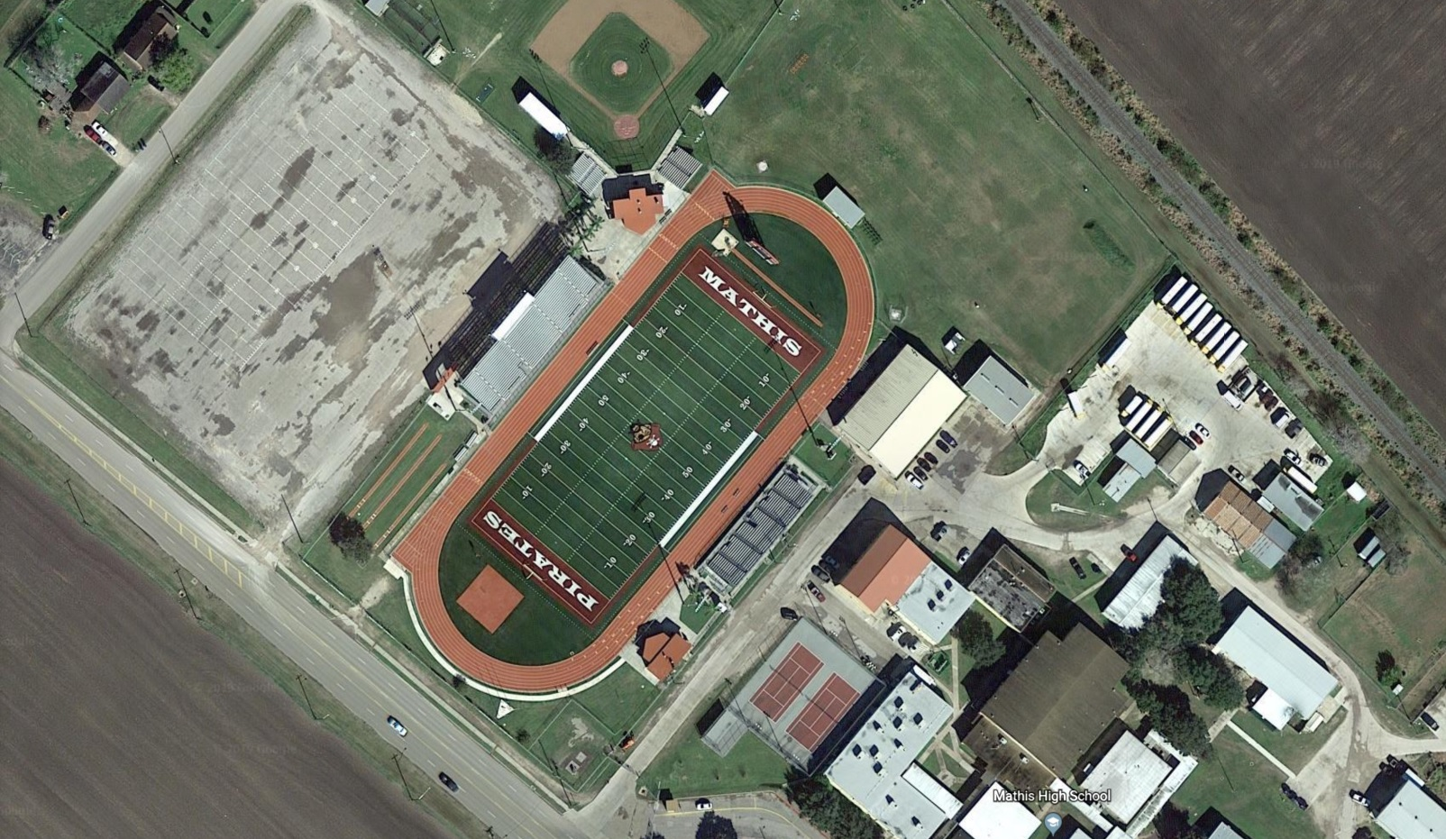
Lifting Gym
Weigh Ins
Hospitality
Please park all vehicles and busses here

Slide 3
Packet Pick Up
Weather permitting, we will have a table set up in the parking lot where the red star is. You will pick up a number and will be able to pay and pick up packets. You will be called in to weigh ins based on the number that you receive when you get to the gate.
Please assure that your lifters stay in the busses until it is their turn to weigh in.
All bands and meal tickets will be in your packets. A diagram of the classroom assignment will also be in your packet.

Slide 4
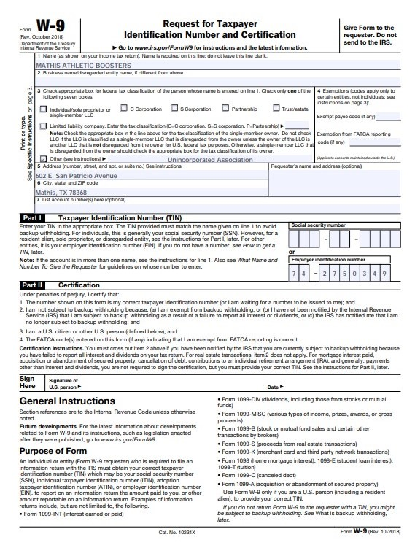
Please Make Checks Payable to:
Mathis Athletic Boosters

Slide 5
Wrist Bands
You will receive bands as follows:
1 lifter =1 Coach
1 spotter/wrapper
2 to 3 lifters = 2 Coaches
1 Spotter
1 wrapper
4 to 5 lifters = 2 Coaches
2 spotters
2 wrappers
Keep in mind, there will only be 4 weight classes lifting at a time. We are trying to keep the floor as non congested as possible, while following the CDC guidelines. This needs to include all sponsors and chaperones as well.

Slide 6
Spectator Tickets
As of now there will be spectators allowed. Our district allows for 2 spectators per lifter during the time of their lifting. Which means, once their time is over, that group of spectators will be asked to leave the gym and it will be sanitized for the next group of spectators.
If you have a full team, you will be given a classroom for the day, where your lifters will be able to camp. They will only be allowed in the gym during their time of lifting. We have set two hours per lifting group, and will have their medal ceremony at the end of each set.
Those teams that feel they will win best overall lifters or Team championships are welcome to stay in their classrooms for the day, and reenter at the end of the final set.
We are asking that you send us the names of the 2 spectators by Wednesday of next week so that our booster will have it at the door. Please use the format below to submit. If they are not on the list, they are not allowed to come in. The tickets will be $8 per spectator. They will have color bands that will only allow them in the gym during a certain time. The booster will know what time their child is lifting based on the weight class.
We do understand that changes may occur by Saturday, but we would like to track our attendees to the best of our abilities. They will simply need to let the booster know who’s spot they are taking to come in.
$8 per Spectator
Lifter's name | Weight class | School | Spectator 1 | Spectator 2

